Slide 1
Ch-05 Style Transfer

Slide 2
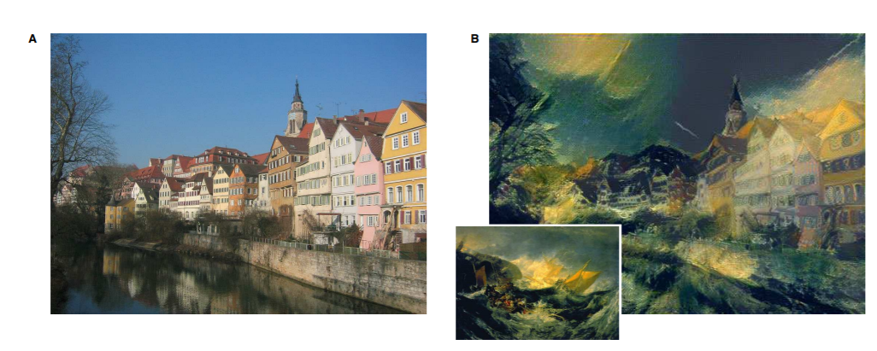
Neural Style Transfer
Neural style transfer is an optimization technique used to take two images, a content image and a style reference image (such as an artwork by a famous painter), and blend them so the output image looks like the content image, but “painted” in the style of the style reference image.
Notes:
1508.06576.pdf (arxiv.org)

Slide 3
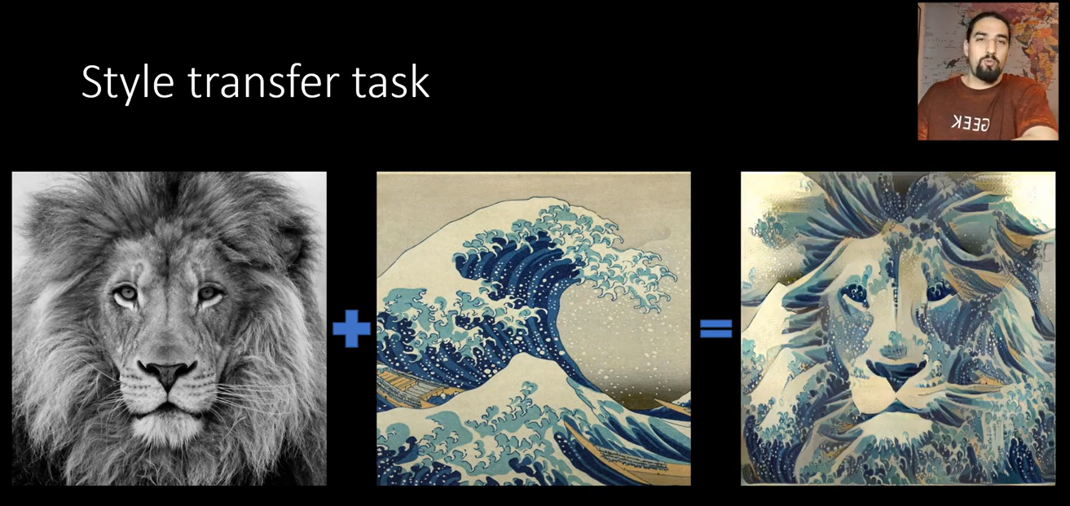

Style transfer task

Slide 4
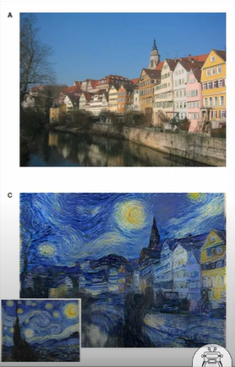
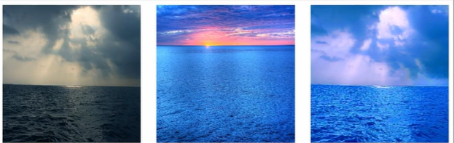
Types of style Transfer
Artistic
Photorealistic

Slide 5
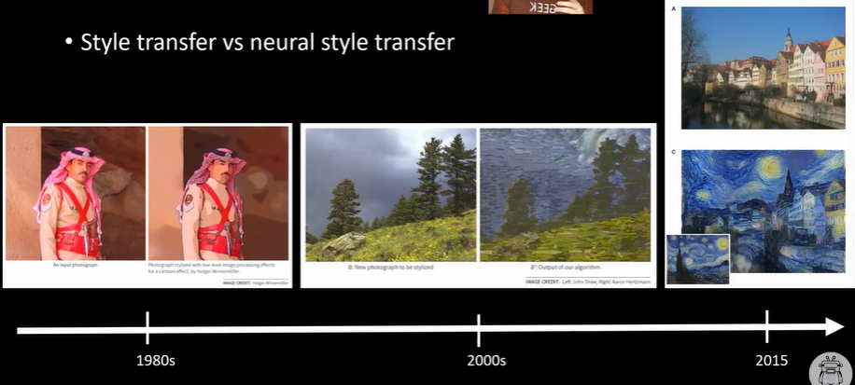
Style transfer vs neural style transfer

Slide 6
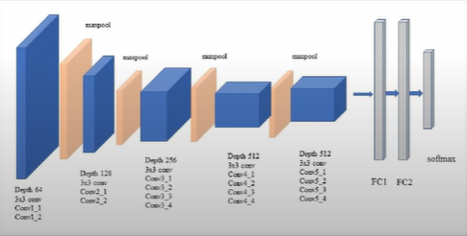
Where it all started
Leon gatys et AI (2015) “A Neural Algorithm of Artistic Style “
“Decoupling” content and style representations inCNN is possible
VGG CNN is the key

Slide 7
VGG-19
VGG-19 is a popular pre-trained model for a variety of computer vision tasks. Researchers pre-trained it on large datasets such as ImageNet, allowing it to capture a diverse set of features from various categories.
We only need the feature extraction part of the VGG

Slide 8
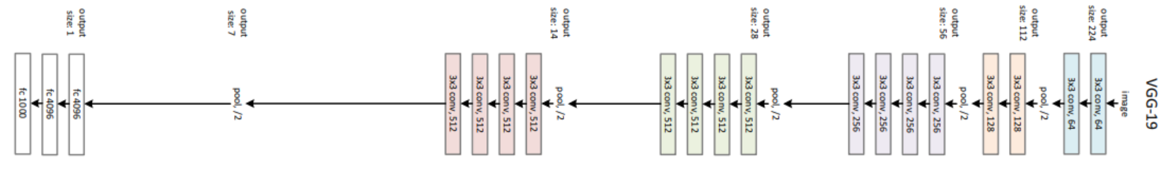
VGG-19 Architecture overview
The Visual Graphics Group (VGG) at the University of Oxford introduced the VGG models, which are known for their simplicity and uniform architecture. VGG-19 has 19 layers, including 16 convolutional layers and 3 fully connected layers. The following are the key features of the VGG-19 architecture:

Slide 9
Input Layer:
Accepts 224×224 pixel images with three color channels (RGB) as input.
Convolutional Blocks (Blocks 1–5):
VGG-19 is made up of five convolutional block sets. Each block is made up of several convolutional layers followed by max-pooling layers.
Convolutional layers commonly employ small 3×3 filters with a stride of one and rectified linear unit (ReLU) activation functions.
To reduce spatial dimensions, max-pooling layers with 2×2 filters and a stride of 2 are used.

Slide 10
Layers that are fully connected (FC6, FC7, and FC8):
There are three fully connected layers (FC6, FC7, and FC8) following the convolutional blocks.
The FC6 and FC7 layers each contain 4096 neurons and employ ReLU activation functions.
The FC8 layer (output layer) contains 1000 neurons with softmax activation, which correspond to the 1000 classes in the ImageNet dataset on which VGG-19 was trained.

Slide 11
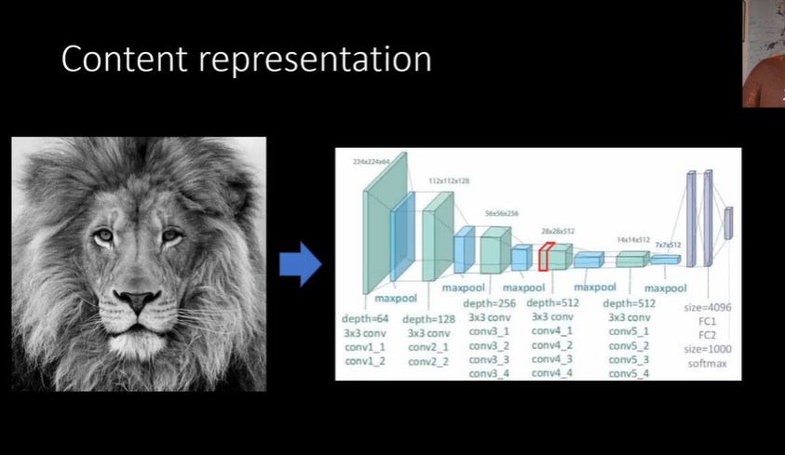


Slide 12
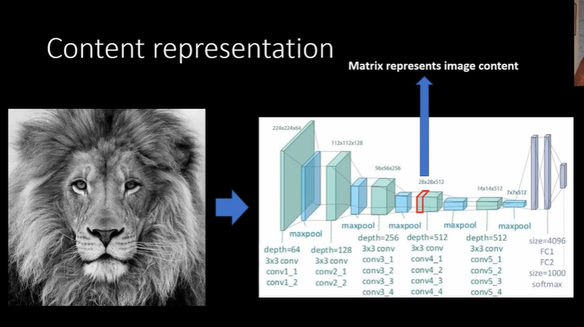
we take some images in them but we feed it through the CNN the vgg not here and we take the feature maps from a certain layer like let's say a comp for one and those future maps are what represents
the content of the input image

Slide 13
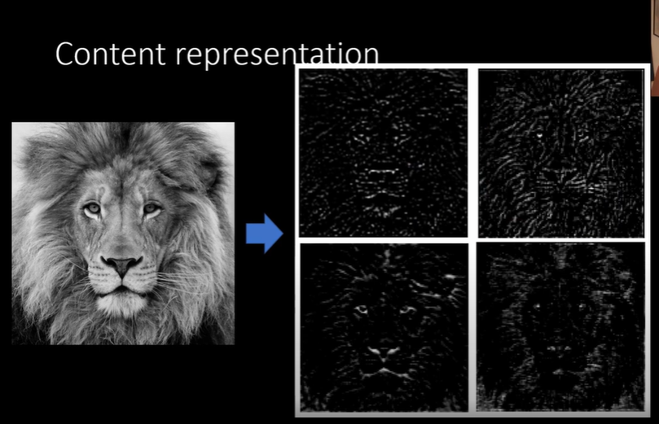

Slide 14
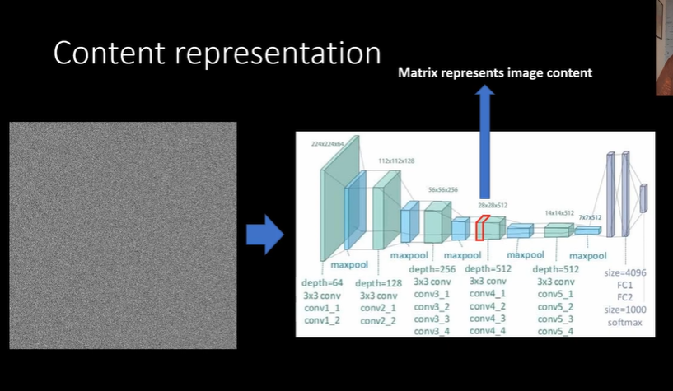

Slide 15
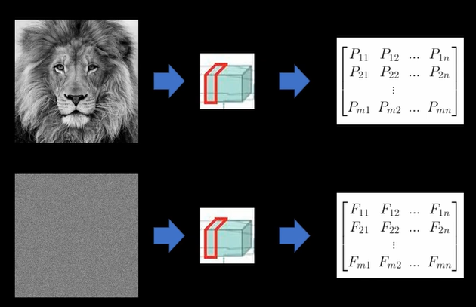

Slide 16
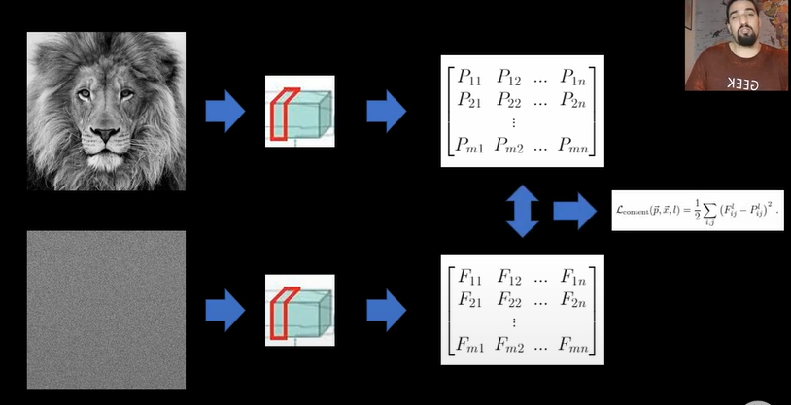

Slide 17
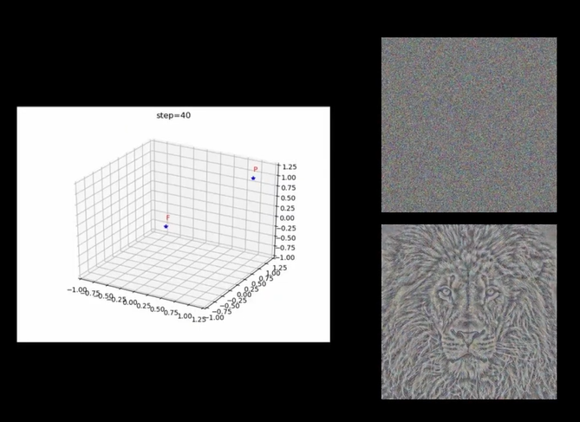

Slide 18
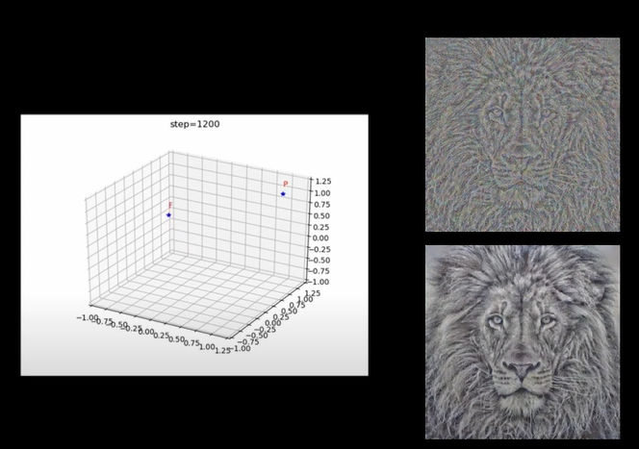

Slide 19
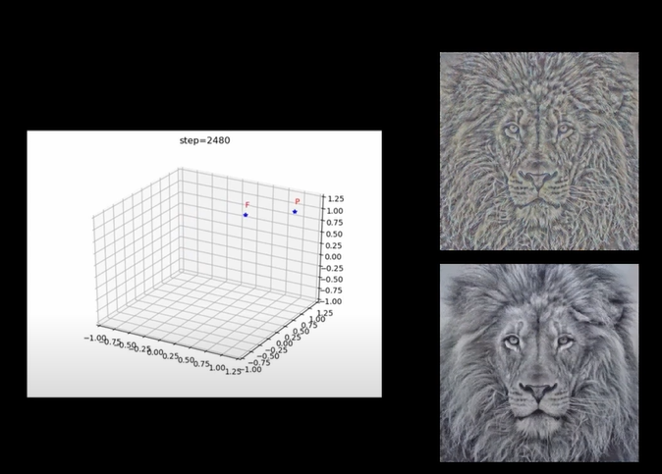

Slide 20
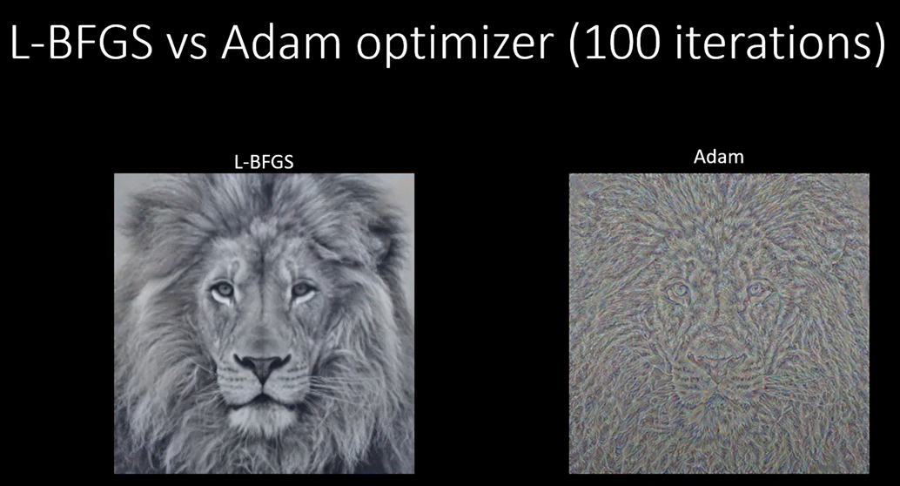

Slide 21
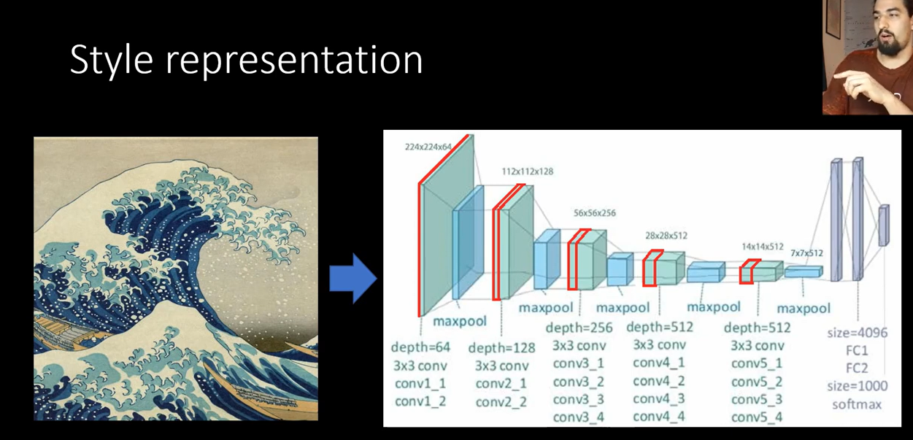
we capture the style of an image so how do we find its style representation so we have this styled image input style image we feed it through this vgg net
and we get a set of feature maps this time taking those from starting from layer conv 1 1 and going through layer and what we do is we construct this feature space over these feature maps using something called Gram transform so we create Gram matrices

Slide 22
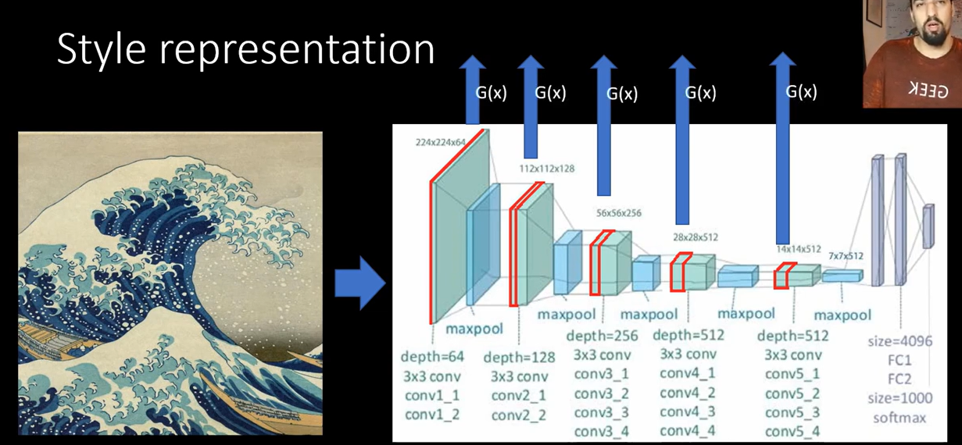

Gram Matrices

Slide 23
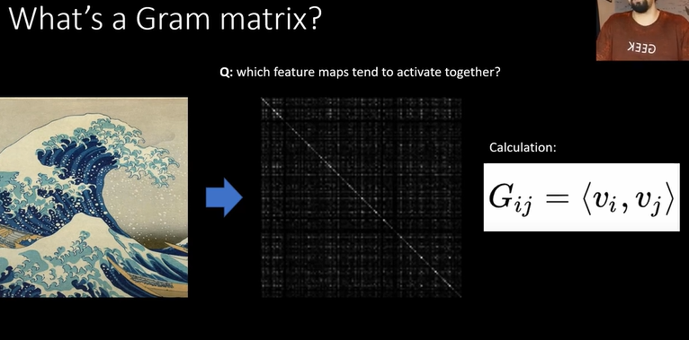
What is Gram matrix?
Given a set V of m vectors ,the Gram matrix G is the matrix of all possible inner products of V

Slide 24
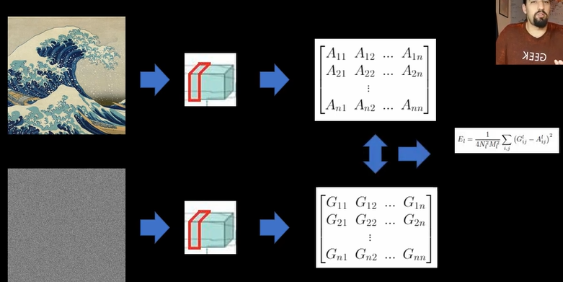
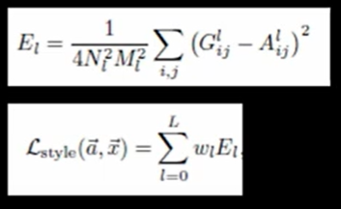
Style loss representations

Slide 25
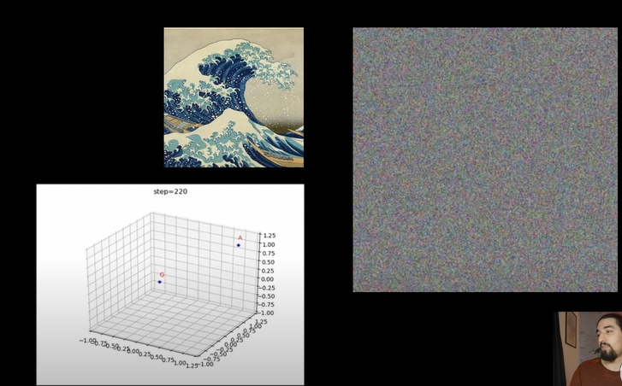

Slide 26
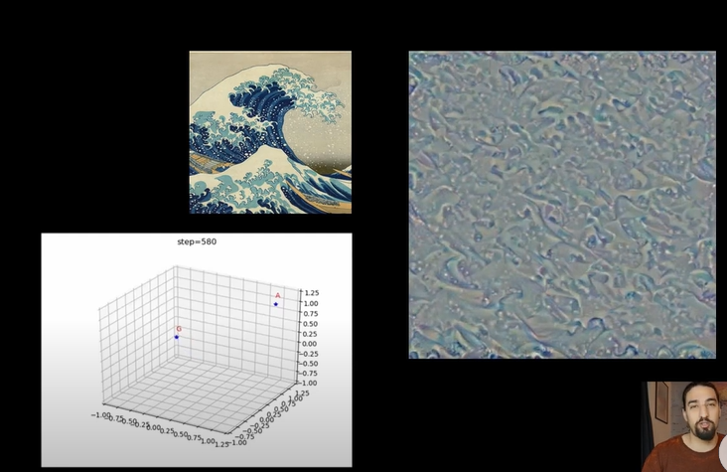

Slide 27
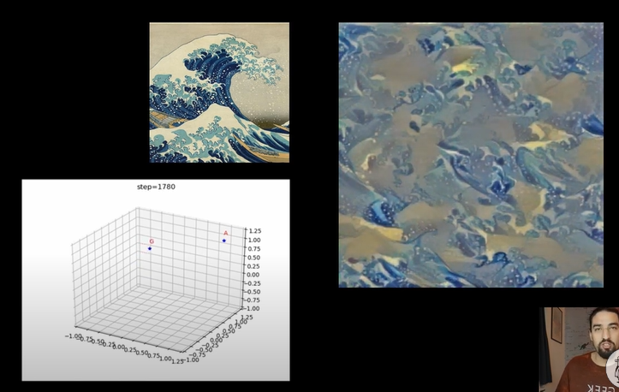

Slide 28
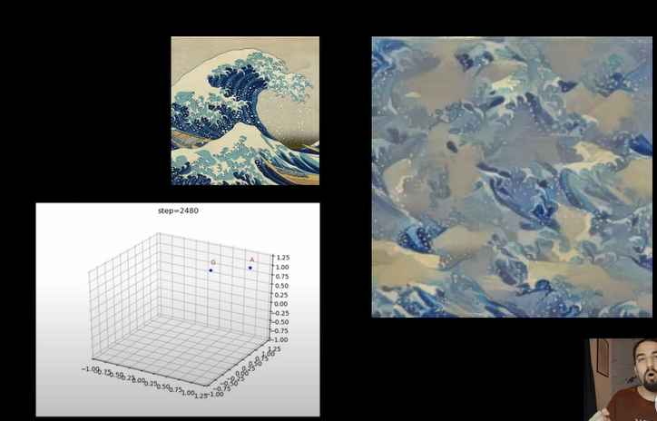

Slide 29
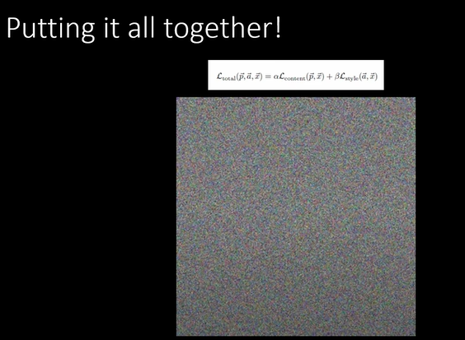

Slide 30
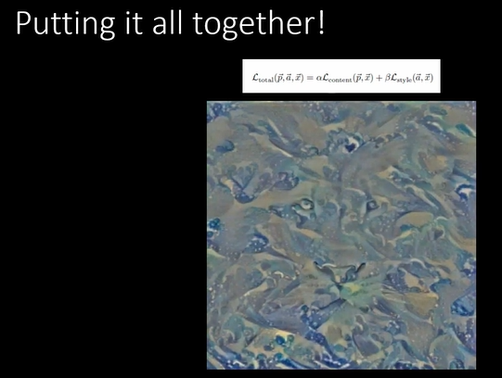

Slide 31
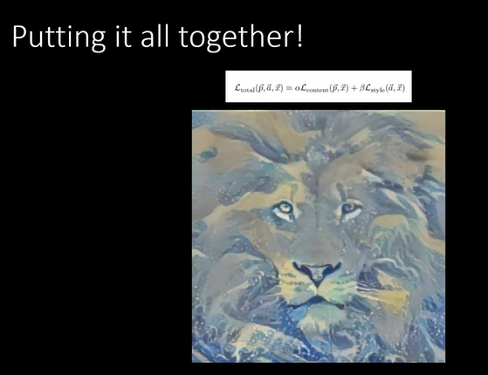

Slide 32
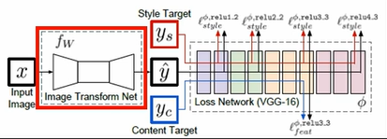
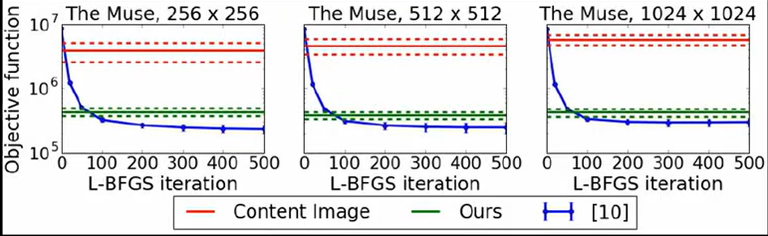
Feedforward method
Use feedforward CNN instead of optimization algorithm(speed)

Slide 33
Feedforward method
The feedforward method in NST offers faster stylization compared to iterative optimization methods since it directly computes the stylized image in a single forward pass through the CNN. This makes it more suitable for real-time or interactive applications where speed is crucial. However, it may sacrifice some flexibility in stylization compared to iterative methods.

Slide 34
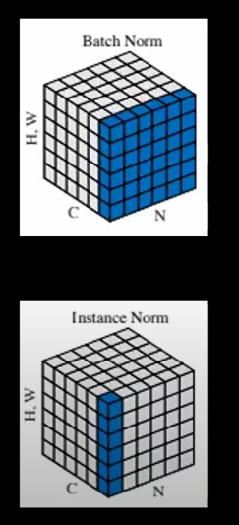
Batch Norm vs Instance Norm
Batch Norm
Use particular feature map from
every single training example (H,W,C)
Instance Norm
Uses A single feature map (H,W)

Slide 35
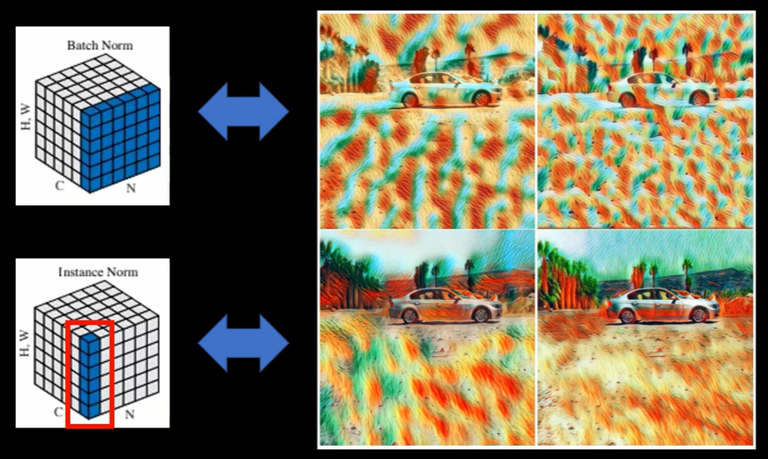

Slide 36
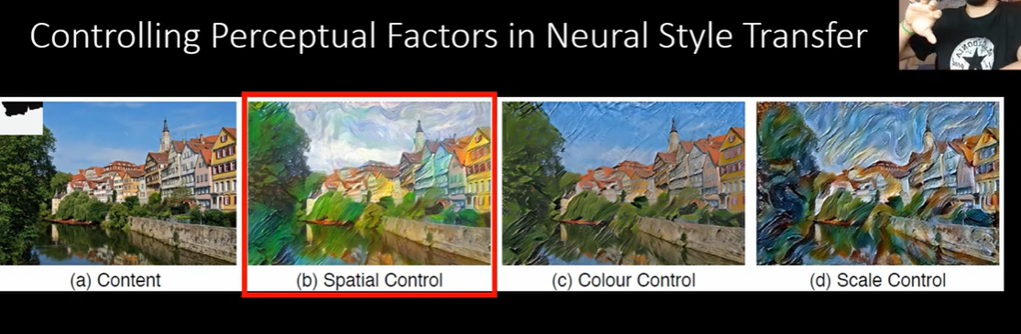

Slide 37
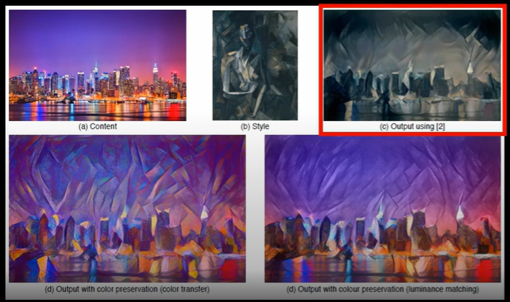
Control Color and scaleing
well one method is to do this you take the content and style images you transform them into some color space where the color information and the intensity information is separable and what you do is that you take the luminance components of style and content images you do the style transfer and then you take the color channels from the complement and just concatenate those with the output and you get the final image

Slide 38
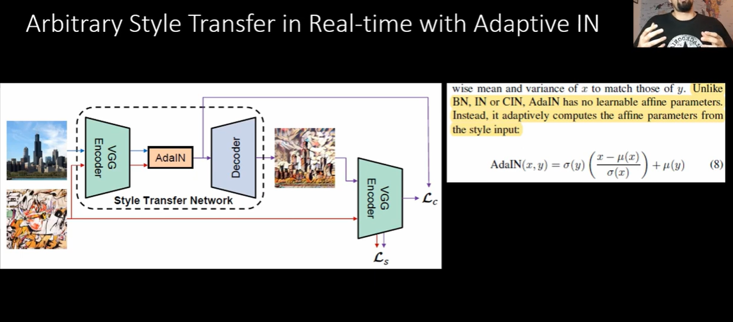

Slide 39
Here's how it works:
Extract Features: The network extracts features from both the content and style images at various layers.
Instance Normalization: Normally, in style transfer, we apply instance normalization to match the statistics (mean and standard deviation) of the features of the content image with those of the style image. This ensures that the style of the generated image matches that of the style image.
Adaptive Normalization: In AdaIN, instead of using fixed statistics (mean and standard deviation) from the style image, we use the mean and standard deviation of the style image to dynamically adjust the normalization parameters for each feature map. This adaptive normalization allows for more flexibility in transferring the style of the reference image to the content image.
Preserving Content: While the normalization is adapted to the style image, the content information is still preserved because the feature maps extracted from the content image are still used as input.

Slide 40
Style Base Gan
Style GAN proposes a lot of changes in the generator part which allows it to generate the photo-realistic high-quality images as well as modify some part of the generator part.
Style GAN uses the baseline progressive GAN architecture and proposed some changes in the generator part of it. However, the discriminator architecture is quite similar to baseline progressive GAN. Let’s look at these architectural changes one by one.

Slide 41
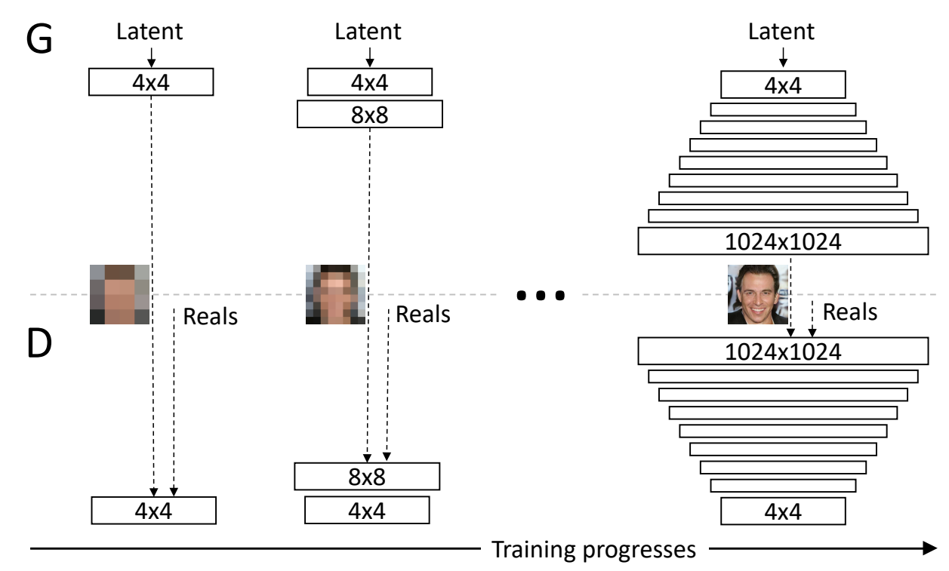
Understanding ProGANs:

Slide 42
Understanding ProGANs:
The primary ideology of the ProGAN network is to build upon layers, starting from the lowest to the highest.
As represented in the image above, we start with a 4 x 4 low-resolution image, to which we then start to add additional fine-tuning and higher parameter variables to achieve more effective results. The network first learns and understands the working of a 4 x 4 image. Once that is completed, we proceed to teach it 8 x 8 images, 16 x 16 resolutions, and so on. The highest resolution used in the above example is 1024 x 1024.
This method of progressive training allows the model to achieve unprecedented results with overall higher stability during the entire training process.

Slide 43
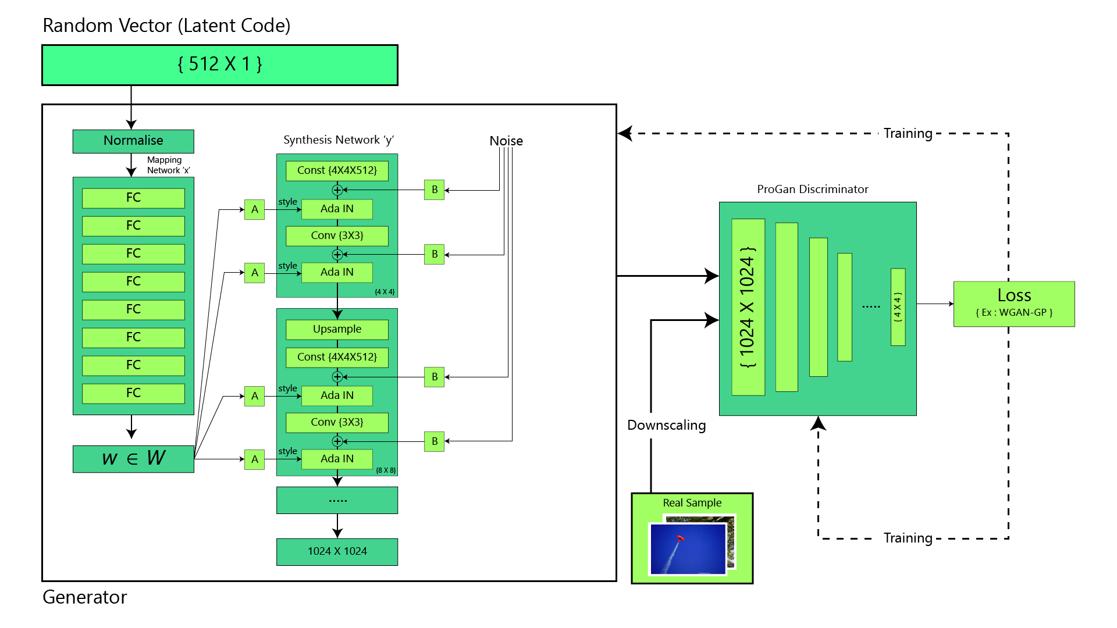
Style Gan Arch.

Slide 44
Style Gan ..
The main idea behind StyleGAN (Style-Generative Adversarial Network) is to generate high-quality synthetic images that closely resemble real images. It accomplishes this by learning the underlying structure and style of images from a dataset and then using that knowledge to generate new images. StyleGAN introduced several innovations, including progressive growing of layers, adaptive instance normalization, and mapping networks, which allow for better control over the generated images' appearance and style.

Slide 45
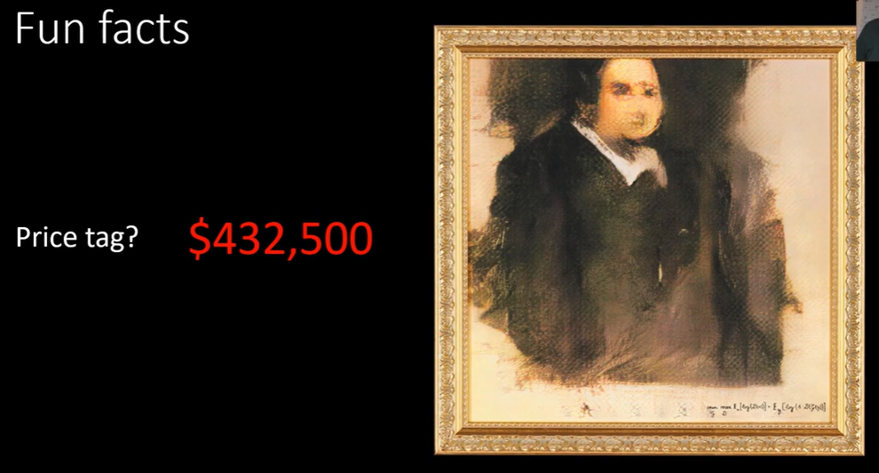
Generated By GAN’s

